Slide 1

All-NBA Teams Prediction
Zayn Sui & Cindy Zhang

Slide 2
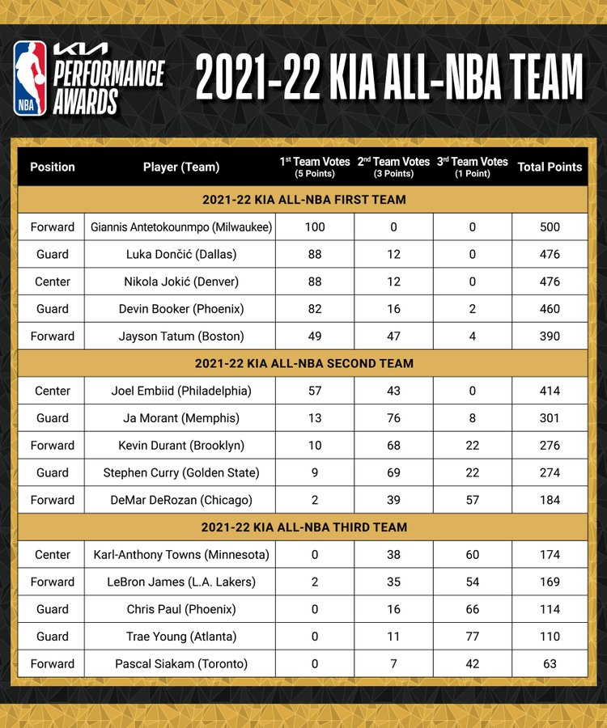
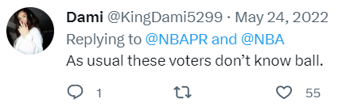
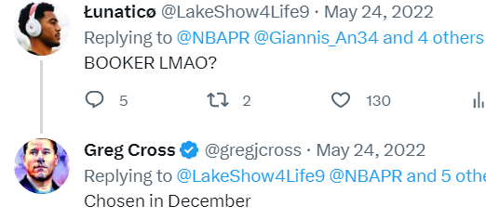
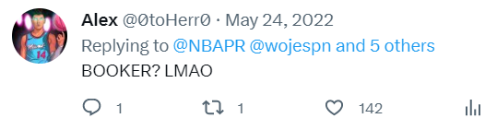
Background
Players with top performance in the regular season
Voting is conducted by a global panel of sportswriters and broadcasters.
Somehow subjective?

Slide 3
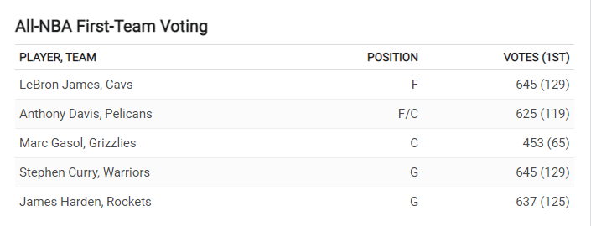
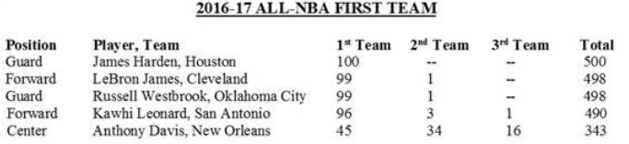
Objective Understanding
Using player performance and team performance to predict members of All-NBA teams in Season 2022-23
2014-15 Season
Target:
the share of votes a player receives

Slide 4
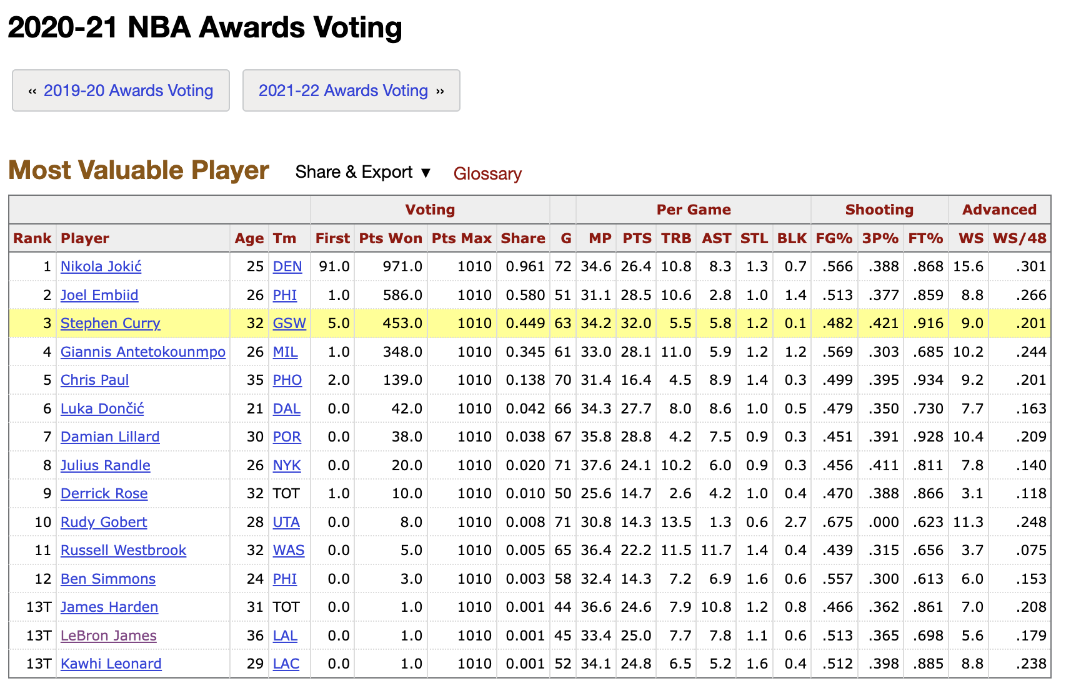
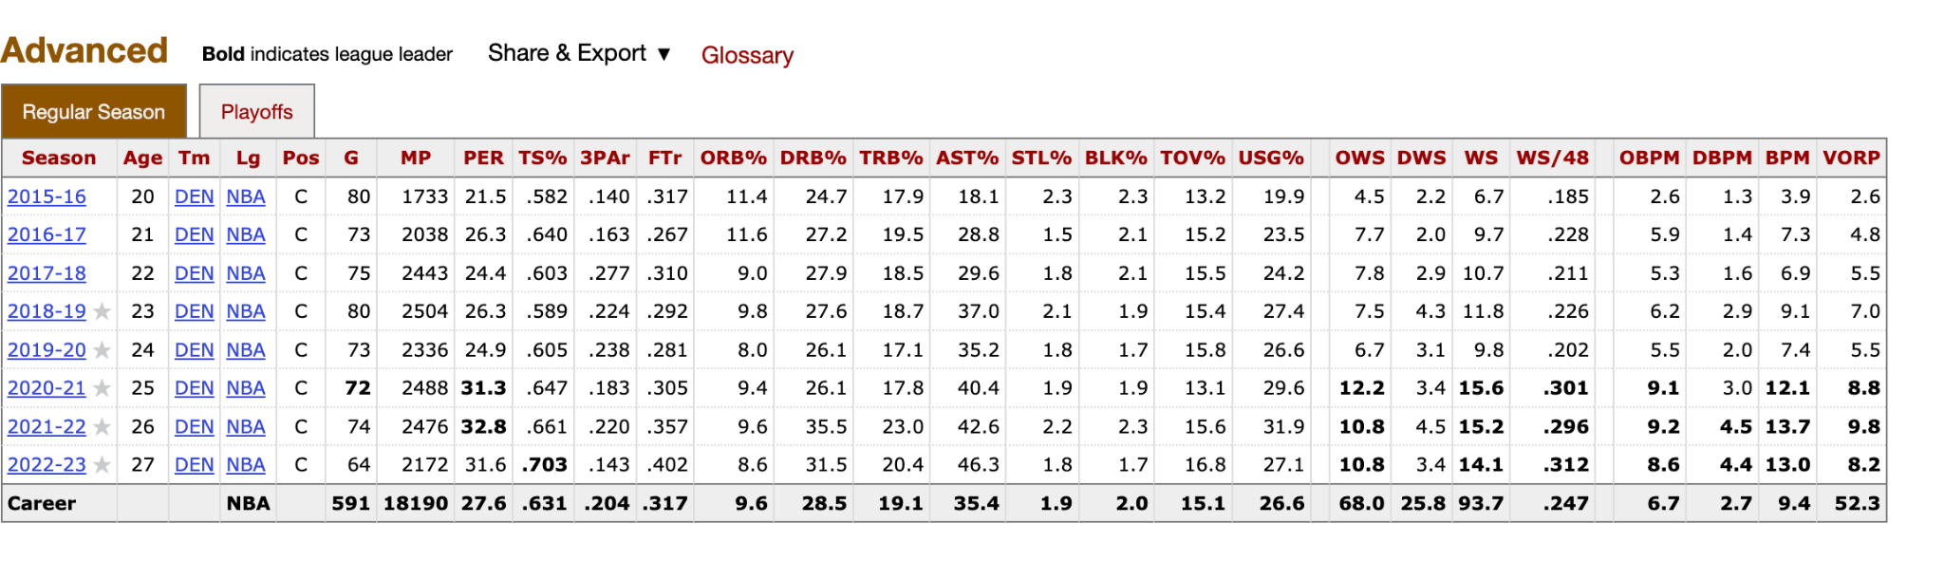
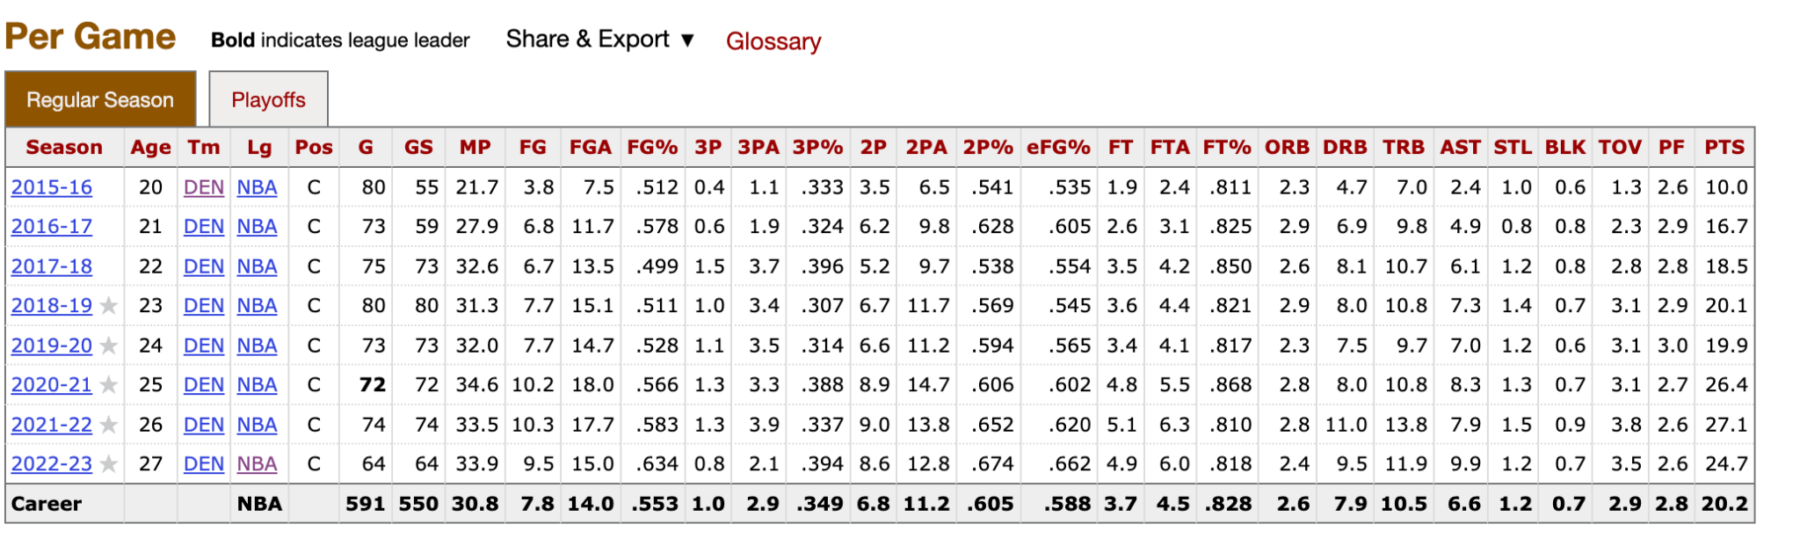
Data Source and Data Collection
https://www.basketball-reference.com/
NBA API
Step1: Scrape the url for players in All-NBA
Teams from Season 1998-99 to Season 2021-22
Step2: Scrape the player’s performance on the
season when he was in ALL-NBA Team in Per-Game table and Advanced table

Slide 5
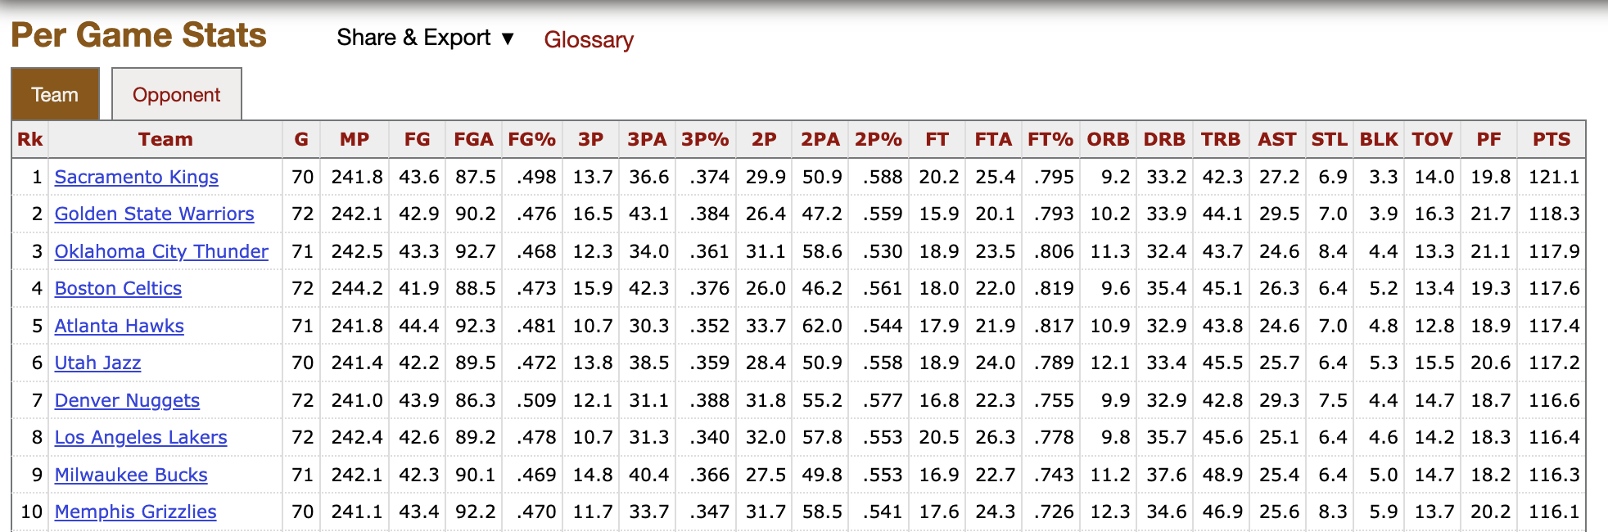
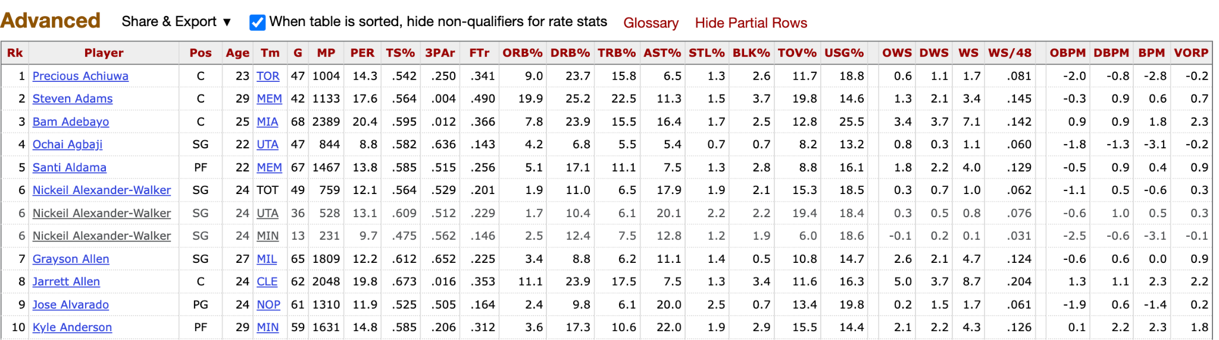
Data Source and Data Collection
https://www.basketball-reference.com/
NBA API
Step3: Scrape the performance for the team when and where the player was in ALL-NBA Team using NBA API
Step4: Scrape the player performance(Per Game and Advance) and performance of the their team in Season 2022-23 for prediction

Slide 6
Data Understanding
Data Range: 1988-99 season - 2021-22 season
Observation: Players who received at least one vote for All-NBA Teams
Feature: 29 variables
Individual Performance
Basic statistics:
PTS TRB AST
STL BLK
FG% 3P% FT%
Team Performance
Advanced Statistics:
WS WS/48 PER TS%
3PAr FTr
ORB% DRB% TRB%
AST% STL% BLK%
TOV% USG%
OWS DWS
OBPM DBPM BPM
VORP WinPCT
Team winning percentage

Slide 7
Modeling
Train Test Split : 80% / 20% on 1988-99 season - 2021-22 season
Prediction: All players in 2022-23 season
Model Used: Supper Vector Regression with Standardization,
Random Forest Regressor,
LightGBM, XGBoost Regressor,
AdaBoost Regressor, CatBoost Regressor

Slide 8
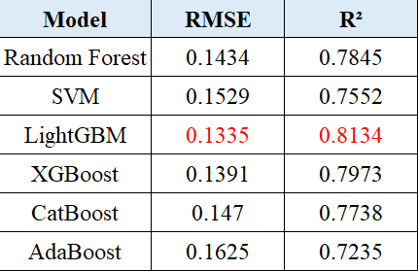
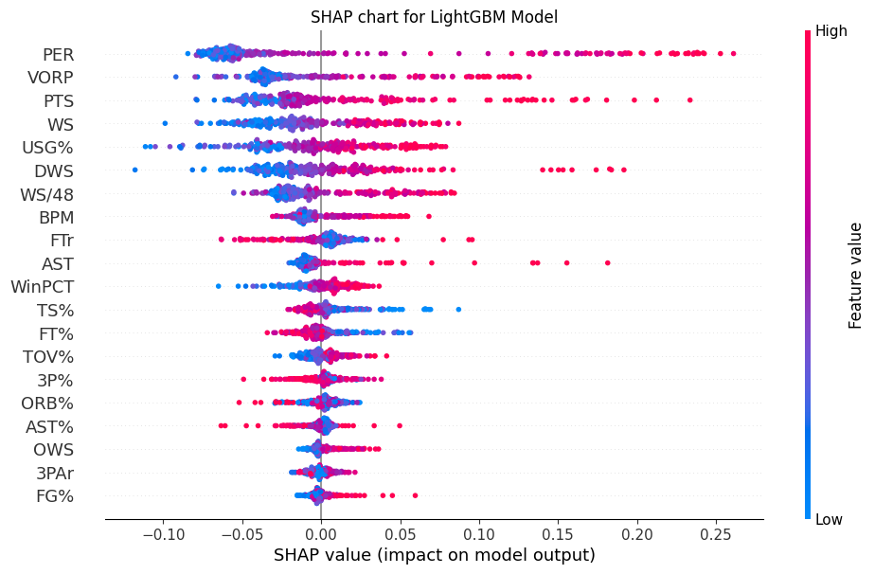
Performance Evaluation

Slide 9
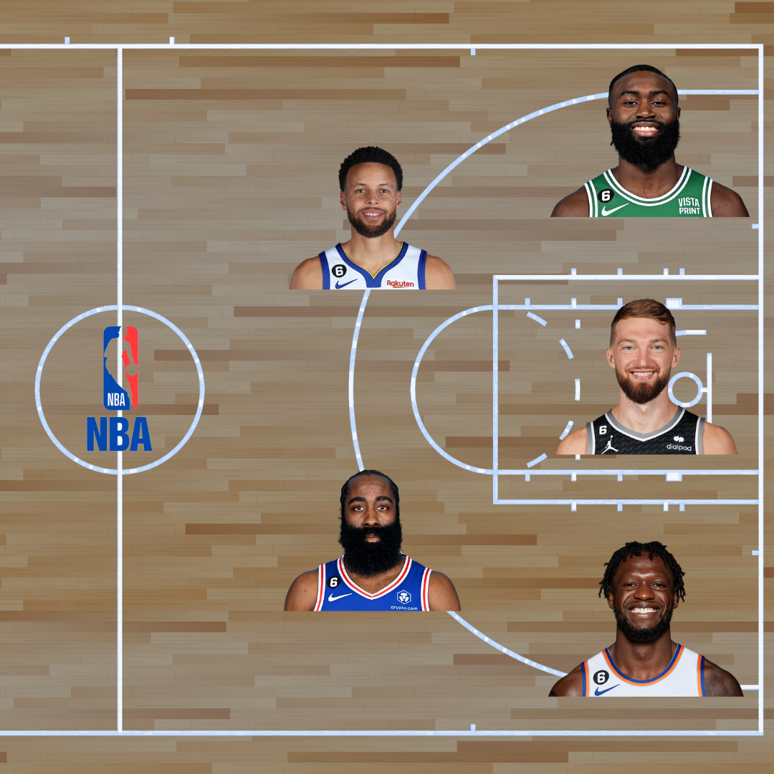
Prediction
All-NBA Third Team:
Stephen Curry
James Harden
Jaylen Brown
Julius Randle
Domantas Sabonis

Slide 10
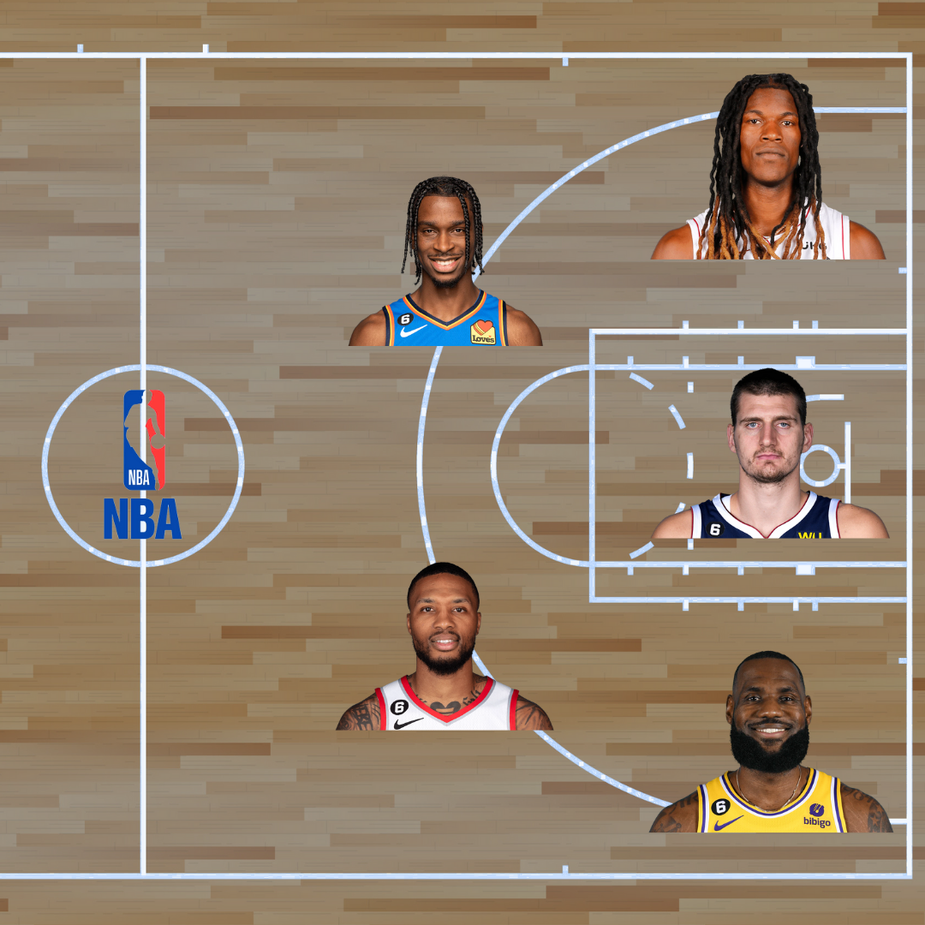
Prediction
All-NBA Second Team:
Shai Gilgeous-Alexander
Damian Lillard
Jimmy Butler
LeBron James
Nikola Jokić

Slide 11
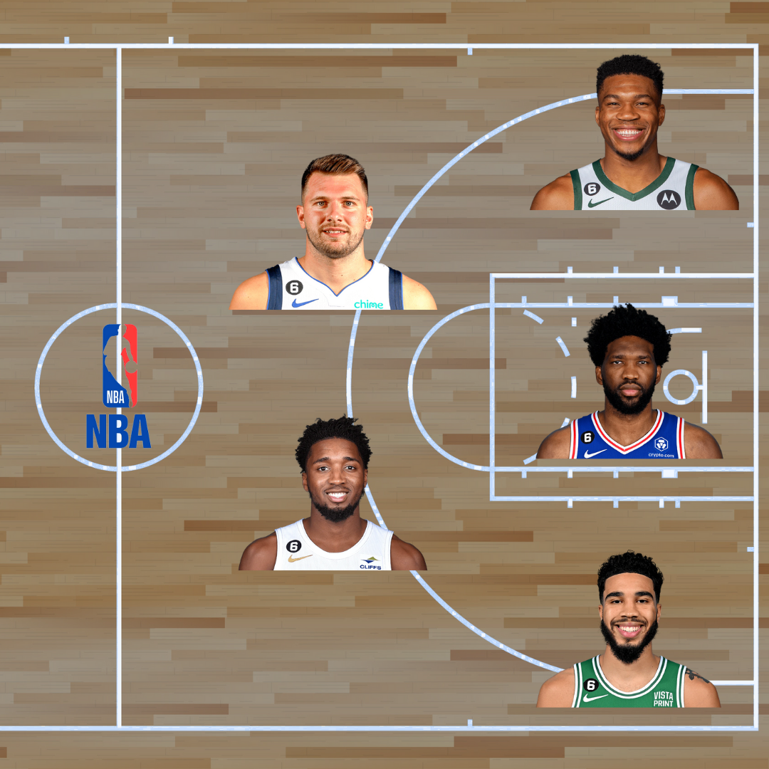
Prediction
All-NBA First Team:
Luka Dončić
Donovan Mitchell
Giannis Antetokounmpo
Jayson Tatum
Joel Embiid

Slide 12
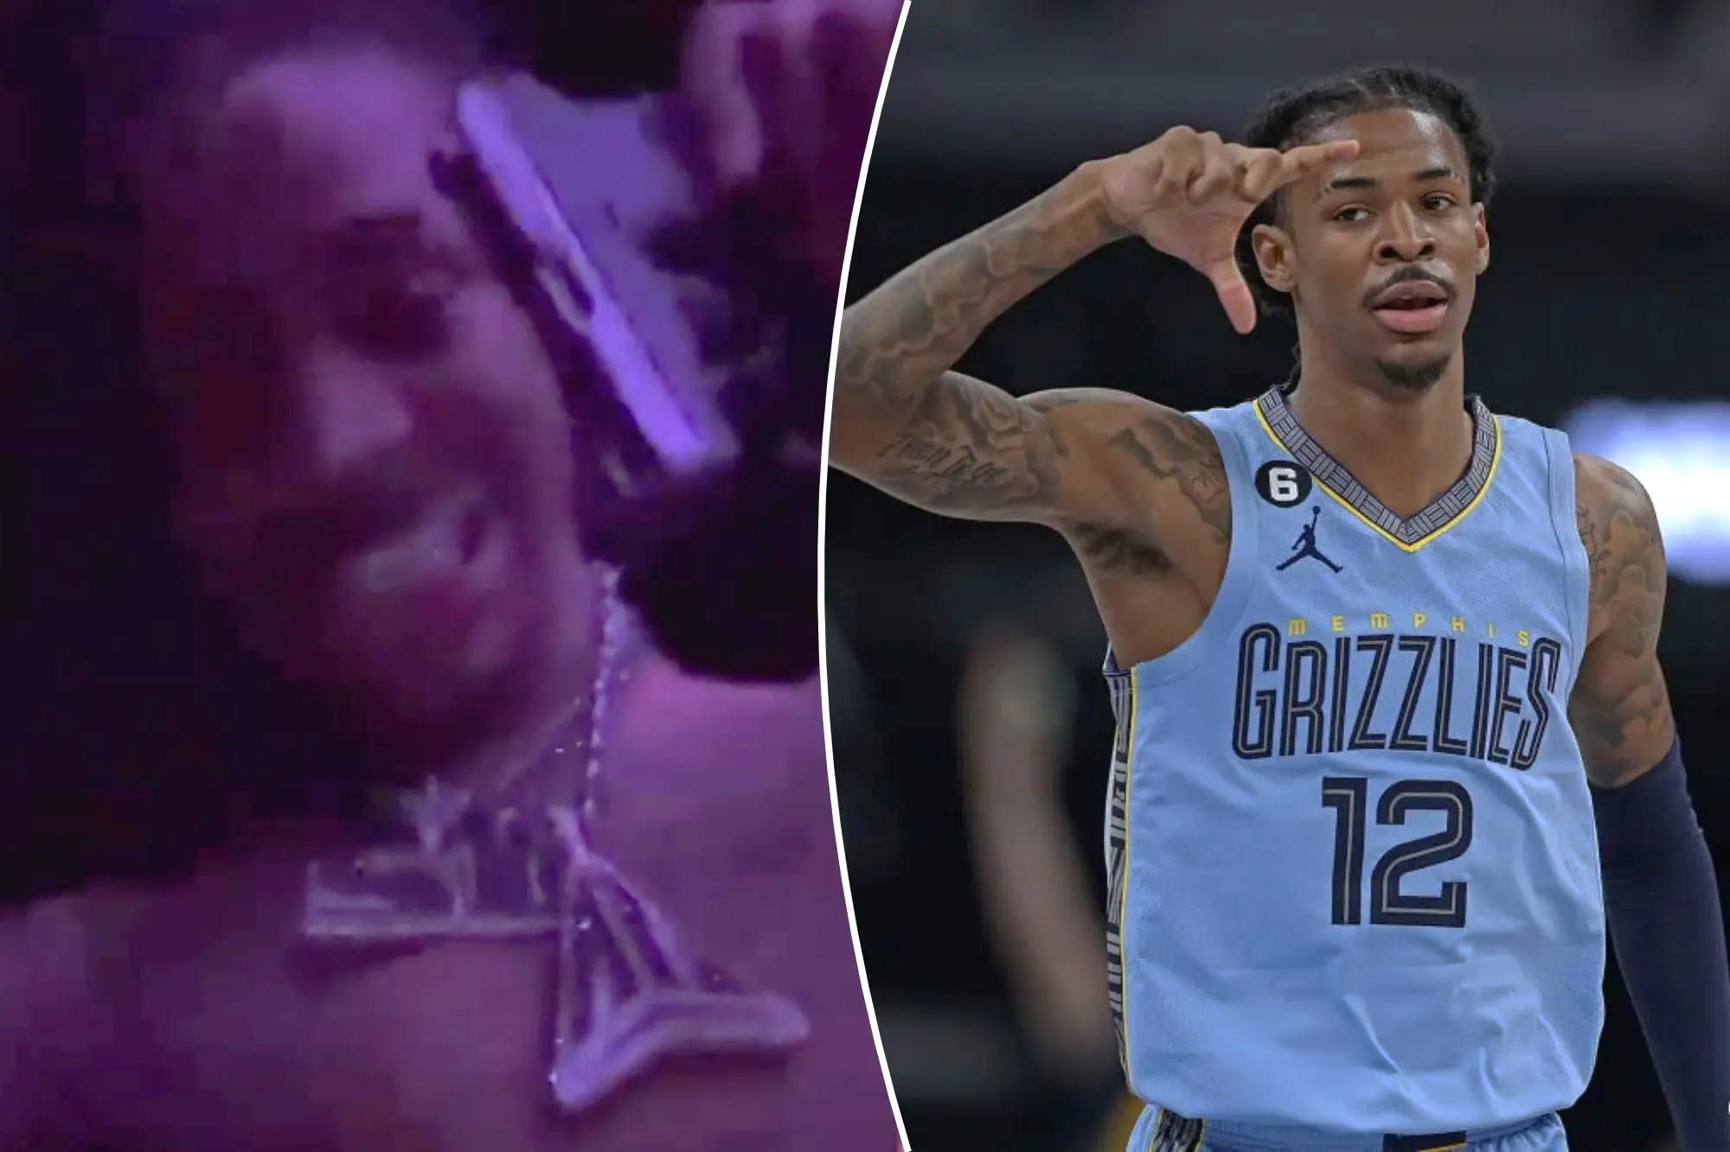
Model Improvement
Variables in other dimensions：
Improvement on the players‘ performance compared to last season
Player’s contribution to team (ie. average of (individual score / overall team score) in one season )
If a player makes any historical records (Russell Westbrook triple-double season)
Player’s behaviour off the court

Slide 13
Thank you !
Any Questions?

